Slide 1
Subject Name : Programming In C. Presentation Title : Looping Statements.
JEPPIAAR INSTITUTE OF TECHNOLOGY
“Self-Belief | Self Discipline | Self Respect”
Department of Computer Science and Engineering
Team Members :
Students Name : Reg.No :
1. Deevan Prasanth S 210619104007
2. Edwin Amala Ciril X 210619104008
3. Elton Rio P S 210619104009
4. Gokul Nath I 210619104010
5. Harikrishna S 210619104011
6. Immanuel Agnelo George 210619104012

Slide 2
ITERATIVE STATEMENTS:
Iterative statements are used to repeat the execution of a list of statements, depending on the value of an integer expression.
C language supports three types of iterative statements.
They are:
While loop
Do-while loop
For loop

Slide 3
While Loop:
The while loop a mechanism to repeat one or more statements while the particular condition is true.
In while loop the condition is tested before any of the statements in the statement block is executed.
If the condition is true, only then the statements will be executed.
If the condition is false, the control will jump to the to the next statement.

Slide 4
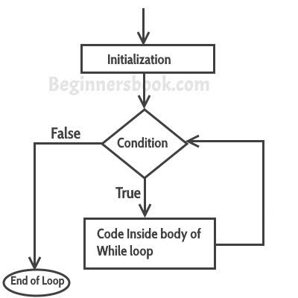
General Syntax And Flow Chart Of While Loop:
Statement x;
While (condition)
{
Statement block;
}
Statement y;

Slide 5
Example:
#include <stdio.h>
Int main()
{
Int i=1;
While(i<=10)
{
Printf(“%d”, i);
i=i+1;
}
return 0;
}

Slide 6
Output:
1 2 3 4 5 6 7 8 9 10
initially i=1 and is less than 10,the condition is
true, so in the while loop the value of i is printed
and the condition becomes more
approachable.

Slide 7
Do-while Loop:
The do-while is similar to the while loop. The only difference is that in a do-while loop, the test condition is evaluated at the end of the loop.
The test condition is evaluated at the end. This indicates that the body of the loop gets executed at least one time.

Slide 8
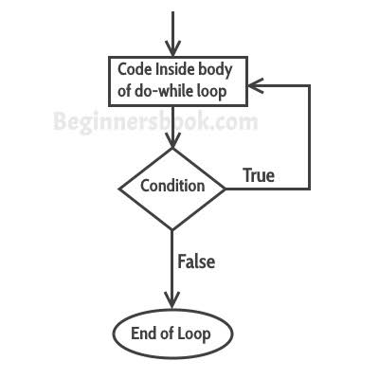
General syntax And Flow Chart of Do-while Loop:
statement x;
do
{
statement block;
}while(condition);
statement y;
{
sum=sum + i;
}

Slide 9
avg=(float) sum/10;
printf(“\n The sum of first 10 numbers=%d”,
sum);
printf(“\n The average of first 10
numbers=%f”,avg);
return 0;
}

Slide 10
Example:
#include<stdio.h>
Int main()
{
int i=1;
do
{
Printf(“\n %d”,i);
i=i+1;
}

Slide 11
Output:
While(i<=10);
return 0;
}
1 2 3 4 5 6 7 8 9 10

Slide 12
For Loop:
The for loop provides a mechanism to repeat a task until a particular condition is true.
For loop is usually known as definite loop because the programmer knows exactly how many times the loop will be repeat.
The number of times the loop has to be executed can be determined mathematically by checking the logic of the loop.

Slide 13
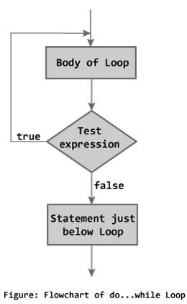
General syntax And Flow Chat of Forloop:
for(initialization; condition;
increment/ decrement/ update)
{
statement block;
}
statement y;

Slide 14
Example:
#include<stdio.h>
Int main()
{
int i, n;
printf(“\n Enter the value of n:”);
Scanf(“%d”, &n);
for(i=1;i<=n;i++)
printf(“\n%d”,i);
return 0;
}

Slide 15
In the code, i is the loop variable. Initially, it is
initialized with value 1. suppose the user enters
10 as the value for n. Then the condition is
checked, since the condition is true as i is less
than n, the statement in the for loop is
executed and the value of i printed. After every
iteration , the value of i is incremented. When
i=n, the control jumps to the return 0
statement.

